Slide 1



ARTIFICIAL INTELLIGENCE AND MACHINE LEARNING
WEEK 2

Slide 2
Introduction to Supervised Learning and Linear Regression

Slide 3
Agenda
Machine Learning:
Intro to machine learning, learning from data.
Supervised Learning, train - test data.
Overfitting and Under fitting
Linear Regression:
Linear relation between two variables, measures of association –
correlation and covariance.
A simple fit, best fit line – measures of a regression fit.
Simple and Multiple linear regression
R squared, Adjusted R squared.

Slide 4
Machine Learning
The ability of a computer to do few tasks without being explicitly programmed for such tasks.
The ability to do these tasks come from the underlying model which is the result of the learning process.
The model is generated by learning from huge volume of data. The data is huge both in breadth and depth reflecting the real world in which the processes are performed.
What machine learning algorithms do?
Search through the data to look for patterns in form of trends, cycles, associations, etc.
Express these patterns as mathematical structures.

Slide 5
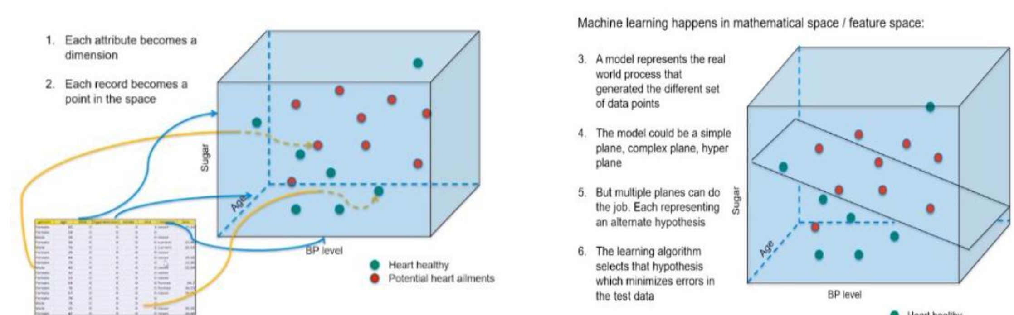
Data Point
A data point in a real world comprises of different attributes which identify it as an entity. Such data points come together to form a data set to be learned from in a mathematical space.

Slide 6
Supervised Machine Learning
Class of machine learning that works on externally supplied instances in form of predictor attributes and associated target values.
The target values are the ‘correct answers’ for the predictor model which can either be a regression model or a classification model (classifying data into classes).
The model learns from the training data using these ‘correct answers/target variables’ as reference variables.
The model thus generated is used to make predictions about data not seen by the model before.
Ex1 : model to predict the resale value of a car based on its mileage, age, color etc.
Ex2 : model to determine the type of a tumor.
If the model does very well with the training data but fails with test data(unseen data), overfitting is said to have taken place. However, if the data does not capture the features of train data itself, we term it as under fitting.

Slide 7
Measure of Association
Covariance
Covariance is a measure of association between two variables.
It represents association in units of the two variables.
It only gives the direction of association i.e., positive or negative. It does not tell us the magnitude of association.
Correlation
Correlation is also a measure of association between two variables.
Moreover, it is a dimensionless quantity and thus enables comparison beyond units.
It measures direction as well as magnitude of the association between two variables.

Slide 8
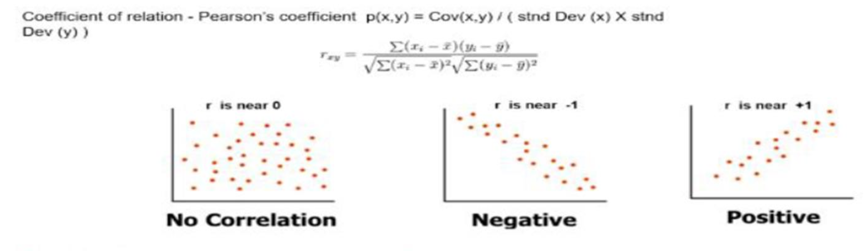
Correlation only measures linear relationship. Zero correlation means no linear relationship exist but there might be non-linear relationship between variables.
Coefficient of correlation is also known as Pearson’s coefficient.
Generating linear models for cases where r is near 0, makes no sense. The model will not be reliable. For given value of X, there can be many values of Y! Non-linear models maybe better in such cases.

Slide 9
Linear Regression
The term “Regression” generally refers to predicting a target value, which is usually a real number, for a data point based on its attributes.
The term “linear” in linear regression refers to the fact that the method models data with linear combination of the explanatory variables (attributes).
In case of linear regression with a single explanatory variable, the linear combination can be expressed as :
response = intercept + constant*explanatory variable

Slide 10
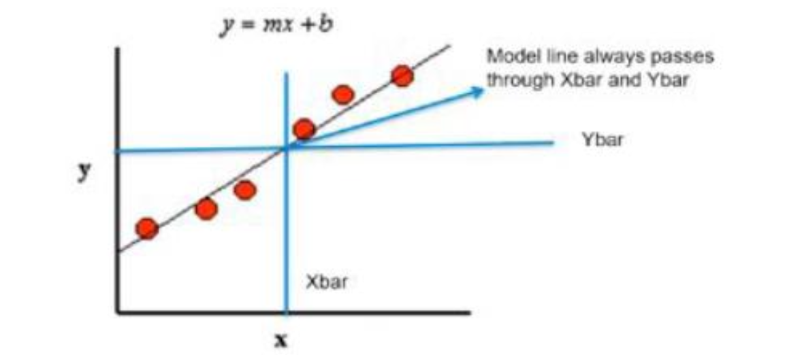
Best Fit Line
Learning from the data, the model generates a line that fits the data.
This line tries to explain the variance in the data.
Our aim is to find a regression line that best fits the data.
In the diagram below, we see the regression line. The red dots are the data points which constitute our data set.

Slide 11
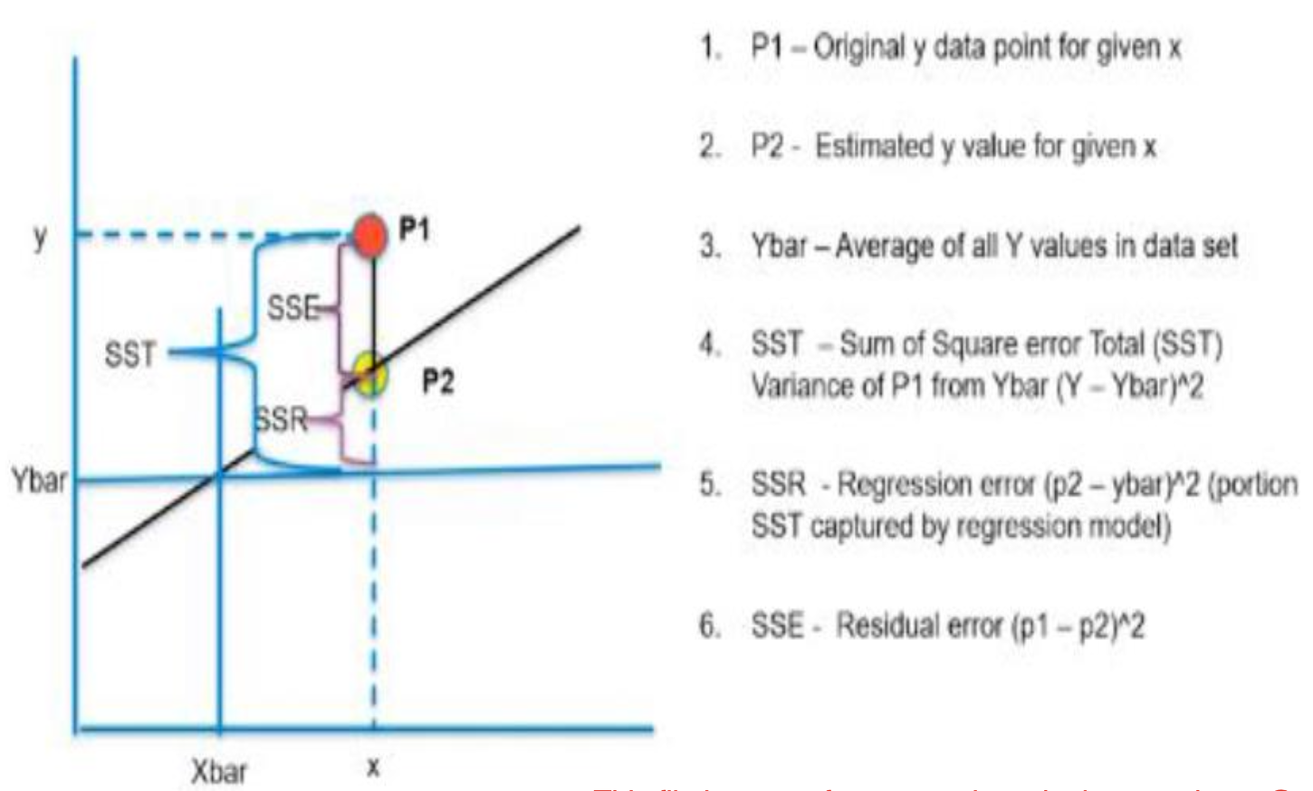
Best Fit Line Contd
The picture shows the different measures of a fit.
R SQUARED VALUE
▪ The r squared is considered a measure of goodness of a fit. It is also known as coefficient of determination.
▪ It is the portion of the variance in data that is covered by the model.
This is given by –
R Squared = (SST-SSE)/SST
= SSR/SST

Slide 12
Multiple Regression
Till now we have seen a simple regression where we have one attribute or independent variable.
However, in the real world, a data point has various important attributes, and they need to be catered to while developing a regression model.
Ex: predicting price of a house, we need to consider various attributes related with this house. Such a regression problem is an example of a multiple regression.
This can be represented by :
target = constant1*feature1 + constant2*feature2 + constant3*feature3 + …..+intercept
The model aims to find the constants and intercept such that this line is the best fit.

Slide 13
Pros and Cons of Linear Regression
Advantages
Simple to implement and easier to interpret the outputs coefficient.
Gives good results when dependent and independent variables have linear relationship.
Disadvantages
Assumes a linear relationships between dependent and independent variables.
Outliers can have huge effects on regression.
Linear Regression assume independence between attributes.

Slide 14
Case Study
There have been lot of studies undertaken in the past, on factors affecting life expectancy, considering demographic variables, income composition and mortality rates.
It was found that affect of immunization and human development index was not accounted in the past.
Important immunization like Hepatitis B, Polio and Diphtheria will also be considered. In a nutshell, this case study will focus on immunization factors, mortality factors, economic factors, social factors and other health related factors as well.
In this case study, we will use linear regression to see the effect of various factors on Life Expectancy.

Slide 15
Case Study Contd.
Attribute Information:
Country: Country
Year: Year
Status: Developed or Developing status
Life expectancy: Life Expectancy in age
Adult Mortality: Adult Mortality Rates of both sexes (probability of dying between 15 and 60 years per 1000 population)
Infant deaths: Number of Infant Deaths per 1000 population
Alcohol: Alcohol, recorded per capita (15+) consumption (in liters of pure alcohol)
Percentage expenditure: Expenditure on health as a percentage of Gross Domestic Product per capita(%)
Hepatitis B: Hepatitis B (Hep B) immunization coverage among 1-year-olds (%)
Measles: Measles - number of reported cases per 1000 population

Slide 16
Case Study Contd.
BMI: Average Body Mass Index of entire population
Under-five deaths: Number of under-five deaths per 1000 population
Polio: Polio (Pol3) immunization coverage among 1-year-olds (%)
Total expenditure: General government expenditure on health as a percentage of total government expenditure (%)
Diphtheria: Diphtheria tetanus toxoid and pertussis (DTP3) immunization coverage among 1-year-olds (%)
HIV/AIDS: Deaths per 1 000 live births HIV/AIDS (0-4 years)
GDP: Gross Domestic Product per capita (in USD)
Population: Population of the country
Thinness 1-19 years: Prevalence of thinness among children and adolescents for Age 10 to 19 (% )
Thinness 5-9 years: Prevalence of thinness among children for Age 5 to 9(%)
Income composition of resources: Human Development Index in terms of income composition of resources (index ranging from 0 to 1)
Schooling: Number of years of Schooling(years)

Slide 17
Case Study Contd.
Concepts to Cover
Simple to implement and easier to interpret the outputs coefficient.
Overview of the data
Data Visualization
Data Preparation
Choose Model, Train and Evaluate
Conclusion
Add on: Statsmodels
Business Insights

Slide 18

QUESTION & ANSWER

